Slide 1

CH 110 : B-tech Laboratory
IIT Guwahati
Experiment 3
Conductometric Titration of a Strong Acid with a Strong Base

Slide 2
CH 110 : B-tech Laboratory
Conductometric titration
IIT Guwahati
Equivalence point or the neutralization point of a titration is the amount of titre just needed to completely neutralize the analyte.
The equivalence point / neutralisation point of a titration can be determined by measuring the conductivity of the solution during the course of titration.
The conductance curve of a titration varies depending on the nature of the acid and base used for titration.
Electrical conductance of a solution depends upon the
1. Number of ions present
2. Ionic mobilities.
Thus, if a strong acid is titrated with a strong base the conductance curve of the titration will be different from that of the titration of a weak acid and a weak base.

Slide 3
CH 110 : B-tech Laboratory
IIT Guwahati
Example: Consider the titration of a strong acid like HCl, with a strong base, like NaOH.
[H⁺ + Cl⁻ ] + [ Na⁺ + OH⁻] ⇒ Na⁺ Cl⁻ + H­₂O (feebly ionised)
Before the base is added the acid solution has a high conductance due to the
highly mobile hydrogen ions.
When NaOH is added to the strong acid the highly
Mobile hydrogen ions are replaced by less mobile Na⁺ ions, thereby, decreasing the
conductance of the solution.
When neutralisation is complete, further addition of alkali will cause the conductance to increase owing to the excess of highly mobile OH⁻ ions.
The conductance will thus be minimum at the equivalence point.
A plot of conductance versus the volume of titrant added will consist of two almost
straight lines intersecting at the neutralisation point.

Slide 4
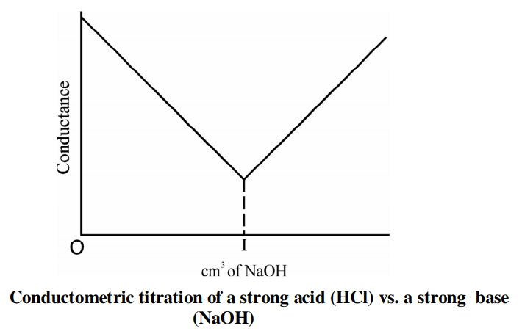
CH 110 : B-tech Laboratory
IIT Guwahati
Equivalence point
Thus, for the titration of a strong acid with a strong base, in the plot of conductance versus the volume of titrant added, two straight lines with different slopes are obtained.
The point of intersection is the equivalence point.

Slide 5
CH 110 : B-tech Laboratory
IIT Guwahati
Requirements:
Conductivity meter
0.05 N NaOH solution
HCl solution (unknown strength)
Plastic Beaker (100 ml, 2 Nos.)
Burette (10 ml)
Pipette ( 25 ml)
Pipette pump 1 no.

Slide 6
CH 110 : B-tech Laboratory
IIT Guwahati
Procedure:
Place 50 ml of 0.01 M KCl solution into a 100 ml beaker and calibrate the conductometer. (your instrument is already calibrated)
Fill up the burette with 0.05 N NaOH solution after rinsing it with the same.
Pipette out 25 ml of the supplied HCl solution into another 100 ml beaker.
Immerse the electrodes of the cell in this and measure the conductivity of the solution.
Add 0.5 ml portions of NaOH solution from the burette. Stir the solution thoroughly after each addition and measure the conductivity of the solution.
In the beginning the conductance value will decrease up to the neutralization point. The conductance will increase while titrating past the neutralization point.

Slide 7
CH 110 : B-tech Laboratory
IIT Guwahati
Procedure:
Find out the approximate neutralization point by plotting the conductance (y-axis) against the volume of NaOH (x-axis). The neutralization point is the intersection of the two straight lines.
Repeat step 2 to 4. This time add NaOH solution in 0.5 ml portions till the volume of NaOH solution added is 1 ml less than required to reach the neutralization point. Then add 0.2 ml portions of NaOH until 1 ml past the neutralization point, so that the sharp change in conductance could be observed. Take five more readings with 0.5 ml portions again noting the conductivity after each addition.
Find out the neutralization point by plotting the conductance (y-axis) against the volume of the titrating solution ( x-axis).

Slide 8
CH 110 : B-tech Laboratory
IIT Guwahati
Observation
Volume of the unknown HCl solution : 25 ml
Sl. no | Table1 |  | Table2
 | Volume of NaOH added (mL) | Conductance (mS) | Volume of NaOH added (mL) | Conductance (mS)
1
2
3

Slide 9
CH 110 : B-tech Laboratory
IIT Guwahati
Calculation
We know,
V1S1 = V2S2
Strength of NaOH (S1): known
Volume of NaOH solution (V1): Determined from the titration
Volume of the unknown HCl solution (V2) : 25 ml
Strength of HCL solution (S2) : Can be calculated now

Slide 10

CH 110 : B-tech Laboratory
IIT Guwahati

